Slide 1


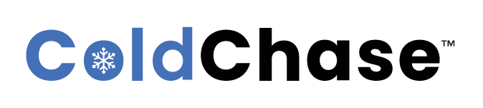
Real-time asset tracking & monitoring
Saas solution
Proprietary to ColdChase Inc.

Slide 2

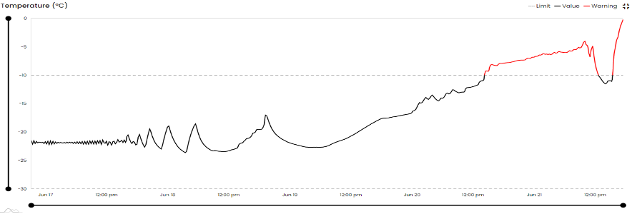
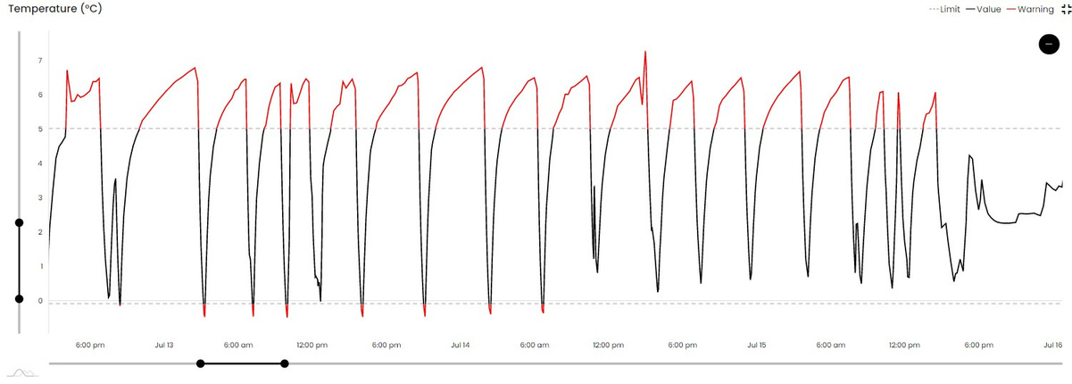
Effective Cold Chain
Monitoring is Important.
Freezer Case Study
ColdChase™ Technologies Saved Our Clients' Time & Money.
Refrigerator Case Study
Proprietary to ColdChase Inc.

Slide 3
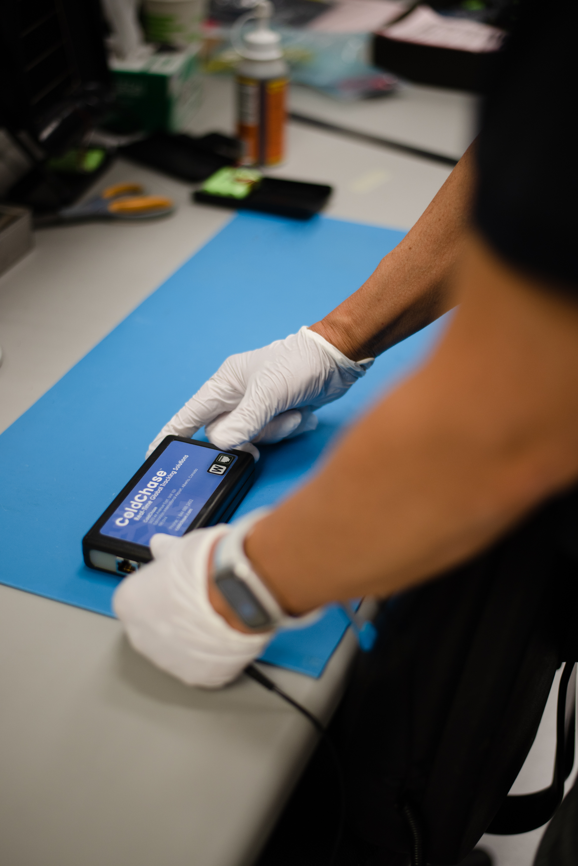



Why ColdChase™?
We prevent losses, not just monitor.
Intuitive & Easy to Use
Secure & Compliant
Smart & Efficient
Proprietary to ColdChase Inc.

Slide 4


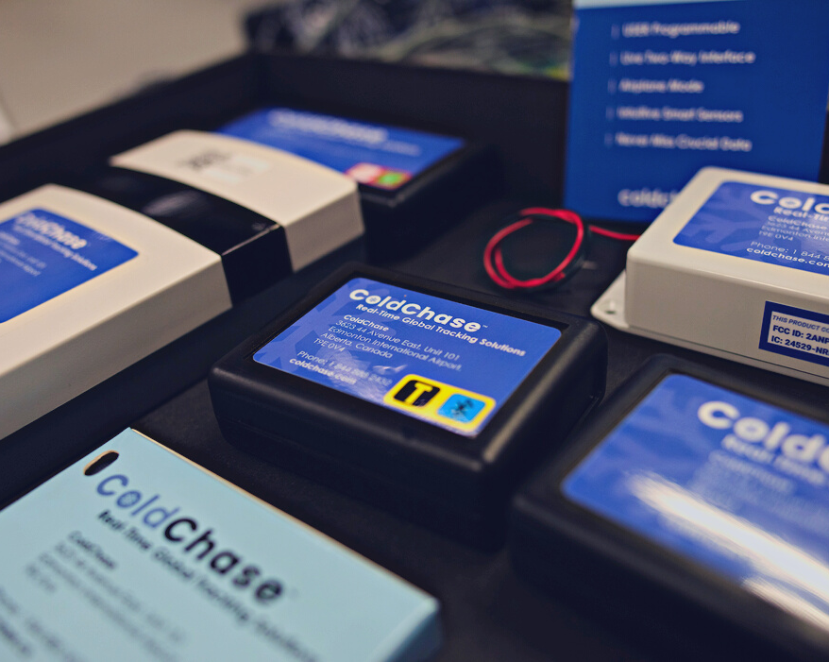
Multi-Sensors Check All the Boxes
AI Trainable
Gas Detection
VOC, VSC, CO, CO2, H, AQI
Environmental Monitoring Including Gases
Environmental Monitoring
Temperature, Humidity,
Pressure, Shock, Light, Vibration and Toxic Gas
Asset Location Tracking
Easy Charging & Reusable
Plane-safe, Industry Compliant
Data Analytics & API capabilities
Asset Location and Tracking
Encrypted data and secured database
BLE, Cell Tower Triangulation,
GPS and Geo-Fence
Proprietary to ColdChase Inc.

Slide 5







PRODUCTS
Monitor real-time
environmental conditions
and asset location data
Automate
warehouse monitoring with
secure cloud system
Set parameter limits, send and receive real-time live alerts, plan routes with geo-fence, and analyze data
Timely respond to excursions by monitoring live data with our mobile applications
COLDCHASE
MULTI-SENSORS
WAREHOUSE
MONITORING
NETWORKS
CLOUD WEB UI &
API SOFTWARE
MOBILE
APPLICATIONS
Proprietary to ColdChase Inc.

Slide 6
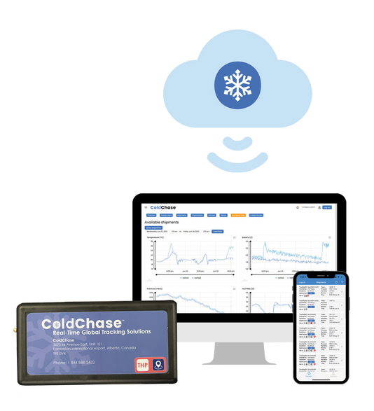

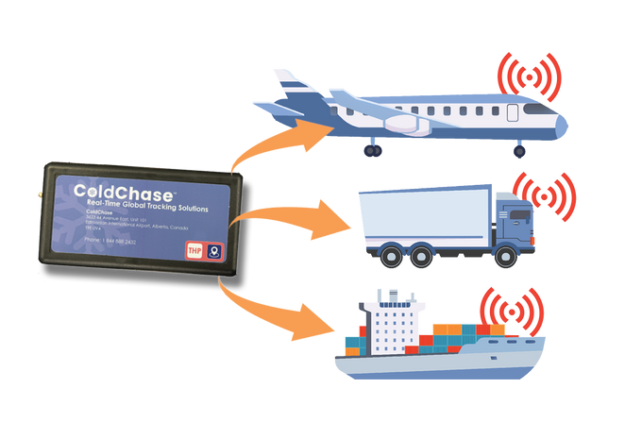
END-TO-END
TRACKING TECHNOLOGY
SHIPMENT
Tracking
Sensors
Global environmental monitoring and asset tracking network you can trust
TRACK
CONNECT
ANALYZE & ACT
Place our reusable sensors
to monitor packages, shipments, assets and storage facilities
Connect sensors to the ColdChase™ cloud system via BLE or cellular connection for real-time, live data
Access actionable insight on the analytics dashboard and mobile Viewer App
Proprietary to ColdChase Inc.

Slide 7
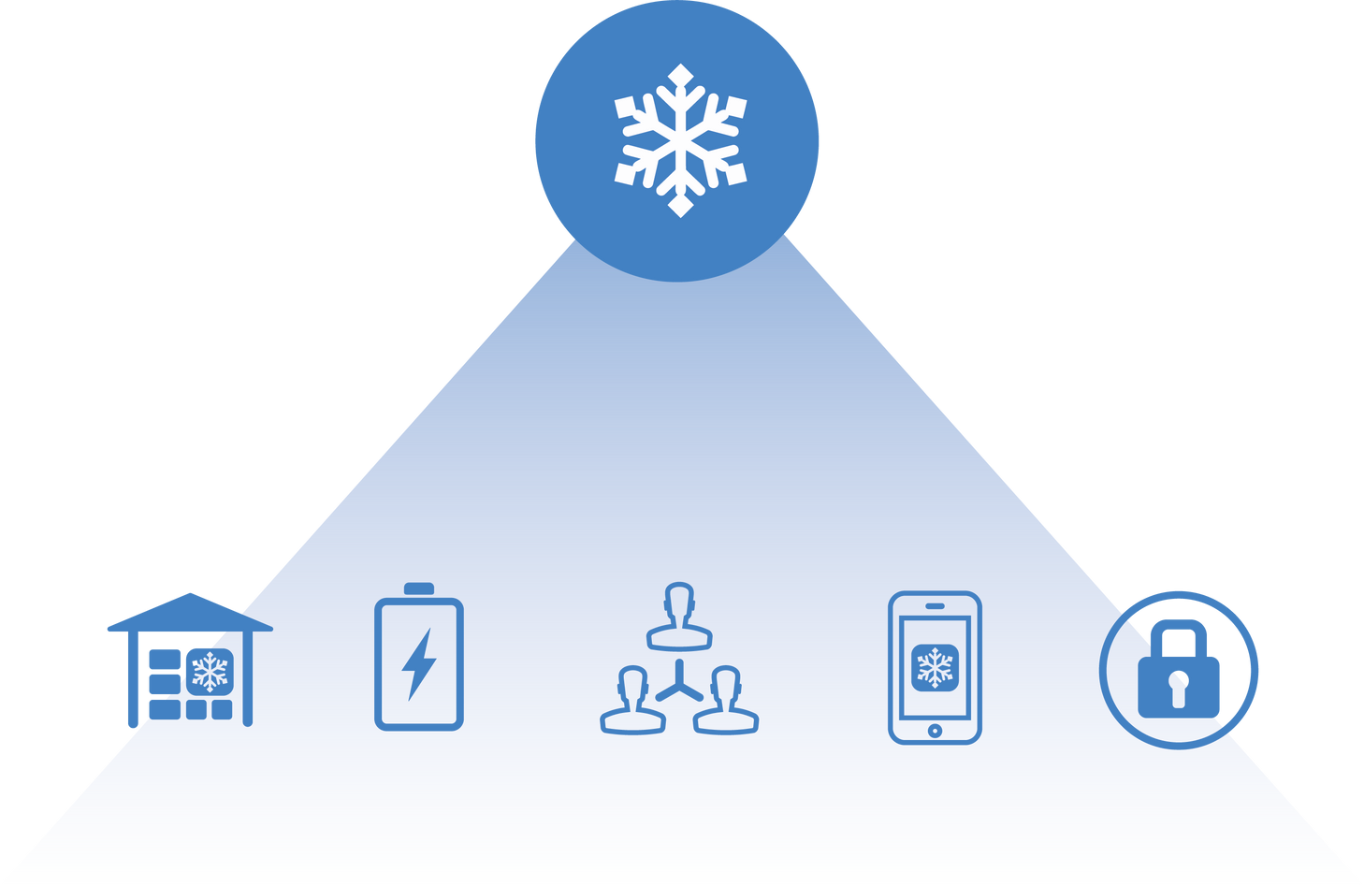
AUTOMATED WAREHOUSE MONITORING NETWORK
WAREHOUSE
MONITORING
NETWORKS
Monitor products in storage facilities wherever you are
Benefit 1
Eliminate Manual Data Logging
Benefit 2
Easy Integration & Connect-and-Forget
Benefit 3
Prevent Issues with Untouched Data
Automation
Power Efficiency
Data Sharing
Actionability
Data Security
Improved workforce
productivity
Uninterrupted
24/7 monitoring
User-friendly
analytics dashboard
Real-time
actionable
insights
Encrypted data
21 CRF Part 11
compliant
Proprietary to ColdChase Inc.

Slide 8
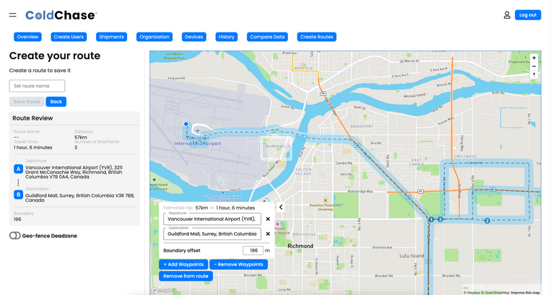
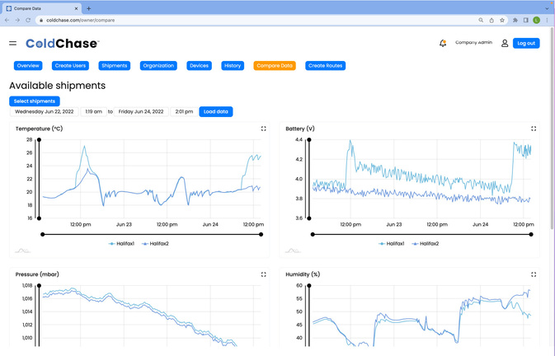
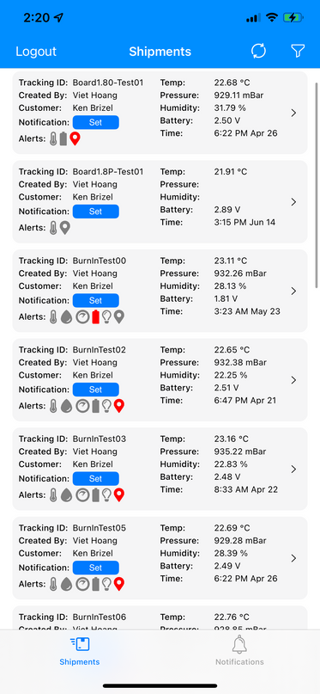
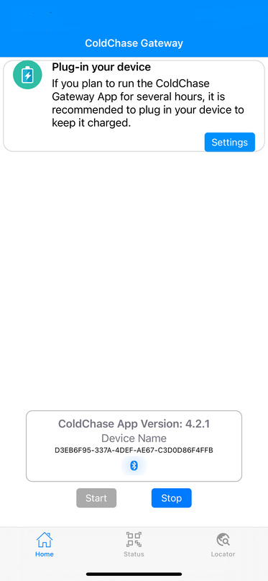


CLOUD WEB UI &
API SOFTWARE
MOBILE
APPLICATIONS
SECURE CLOUD-BASED APPLICATIONS
Optimize logistics performance with an intuitive dashboard allowing users to configure parameters and alert settings
  Route planning & tracking
  User-configurable parameter limits & alerts
  Data archive & audit trail
  API (Application Programming Interface)
  Team sharing for efficient management
  Secure ColdChase™ cloud database
  Gateway App for BLE for two-way live data transmission to the cloud
  Viewer App provides a quick glimpse of real-time, live data and alert notifications
Analytics Dashboard
Viewer App & Gateway
Proprietary to ColdChase Inc.

Slide 9
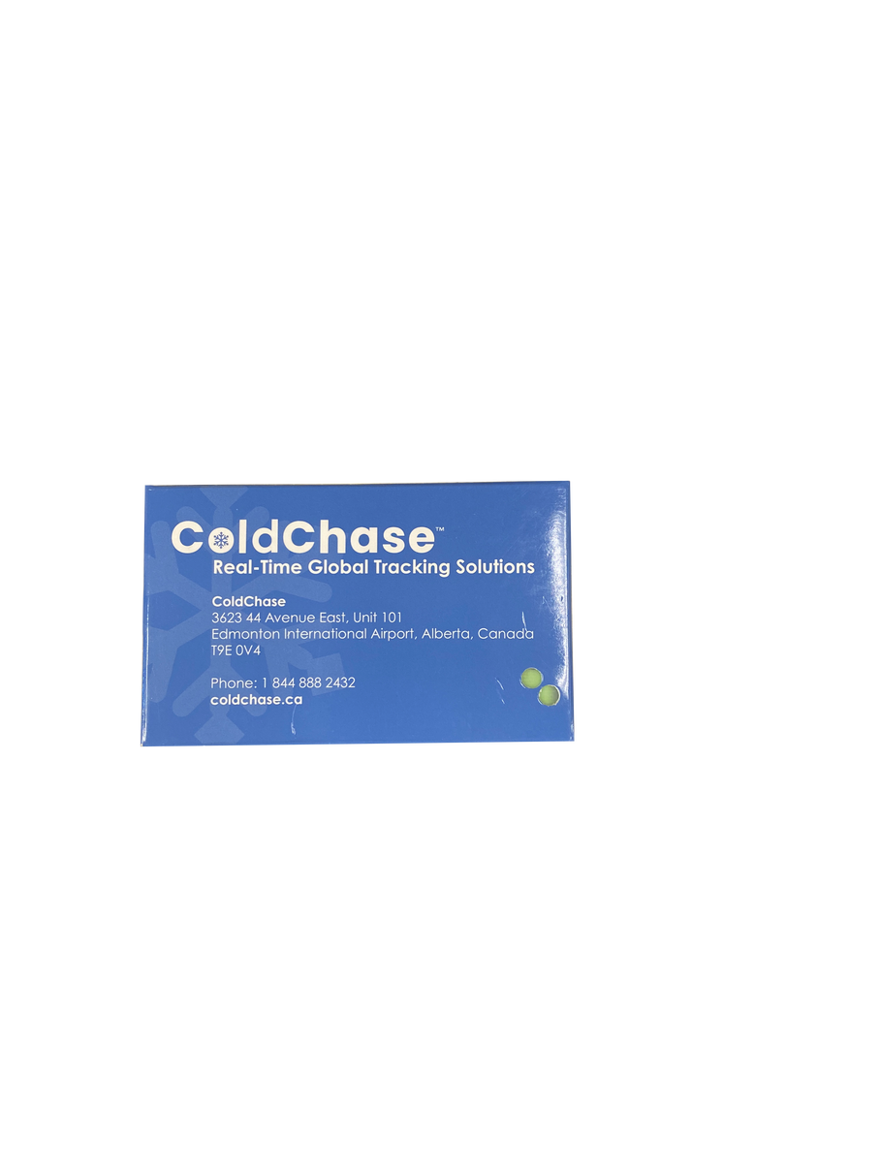
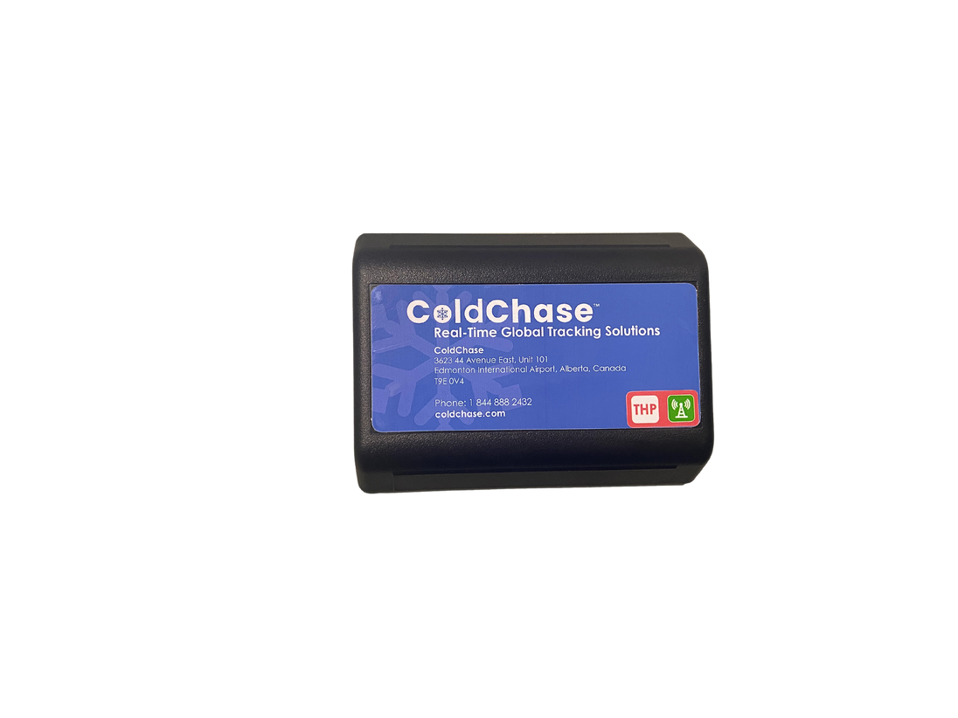
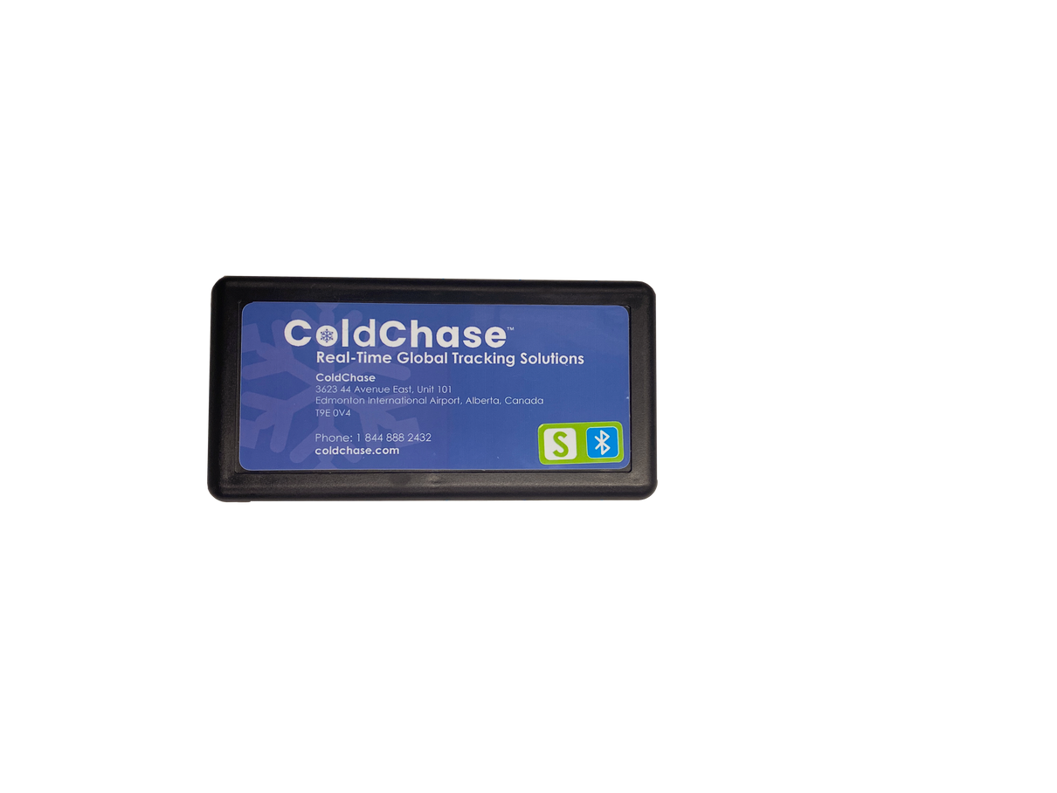
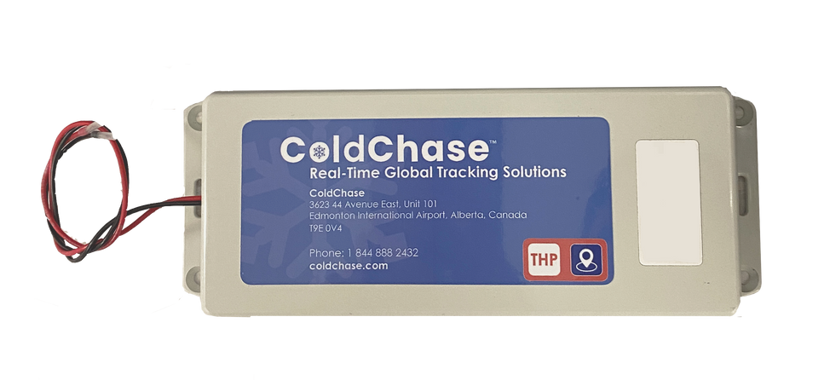
Our reusable tracking sensors come in
different case designs and sizes.
ABS REUSABLE CASE
EXTENDED LIFE SENSOR
LIGHTWEIGHT PAPER CASE
TRUCK MOUNT CASE
IP65 Tested for durability
Durable ABS Case with additional batteries for longer shipping duration,
ideal for sea freights.
Designed for global postal returns
Designed to mount in a truck
with access to vehicle power,
has an internal battery backup
Proprietary to ColdChase Inc.

Slide 10

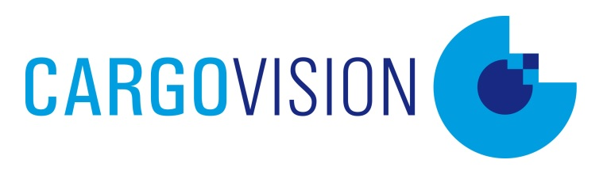

Book a trial to experience ColdChase™ solutions.
Contact our GSA, Norm Richard with Cargovision at norm.richard@cargovision.ca
or visit cargovision.ca.
Proprietary to ColdChase Inc.

Slide 11




50% Loss
Challenge 1
CASE STUDIES
Failure to identify and respond timely to alerts resulting in spoilage
$150B
Recovered
Challenge 2
Increased insurance claim costs, fees and labour
8% GHG
Challenge 3
Lack of real-time monitoring and control over sensitive and valuable goods
Proprietary to ColdChase Inc.

